Slide 1

Accounting for uncertainty and applying management strategy evaluation to understand potential risks and trade-offs
Northwest Fisheries Science Center
Chantel Wetzel
Northwest Fisheries Science Center
ICES Data-Limited Methods
September 15, 2016

Slide 2
Harvest Control Rules
“…harvest control rules – rules which specify a pre-agreed course of management actions depending on the status of the resource.”
-Gabriel and Mace, 1999
Can be applied to maintain stock at or near target biomass, included added precaution, or be used to incorporate stability.

Slide 3
Adaptive Management Cycle
Catch
Monitoring
Fish Stock
Fishery
Assessment/ Empirical Measure
Management Response
Harvest Control Rule
Adapted from Dowling et al. 2015 Fisheries Research 171: 130-140

Slide 4
Example harvest control rule
OFL
Catch or Effort
Reduce
Harvest
F_{MAX}
No
Harvest
B/B₀
Target
1.5
0
Limit

Slide 5
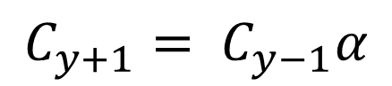
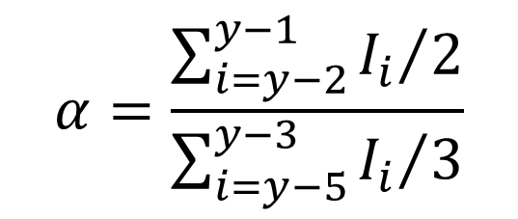
Data-limited harvest control rules Example 1
Catch multiplier based on indicator
Index of abundance example termed HCR1:
$$C_{y+1}= C_{y−1}α$$
$$α=\frac{\sum_{i=y−2}^{y−1}{{I_{i}}/2}}{\sum_{i=y−5}^{y−3}{{I_{i}}/3}}$$
Source: Jardim et al. 2015

Slide 6
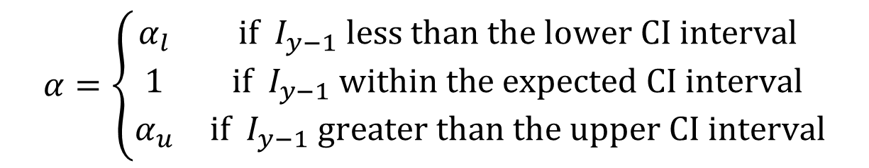
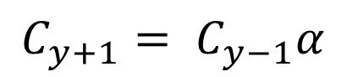
Data-limited harvest control rules Example 1
Catch multiplier based on indicator
Confidence interval around an index of abundance termed HCR2:
$$C_{y+1}= C_{y−1}α$$
$$α=\left\{\begin{matrix}α_{l} & \text{if} I_{y−1} \text{less} \text{than} \text{the} \text{lower} \text{CI} \text{interval} \\ 1 & \text{if} I_{y−1} \text{within} \text{the} \text{expected} \text{CI} \text{interval} \\ α_{u} & \text{if} I_{y−1} \text{greater} \text{than} \text{the} \text{upper} \text{CI} \text{interval}\end{matrix}\right.$$
Source: Jardim et al. 2015

Slide 7
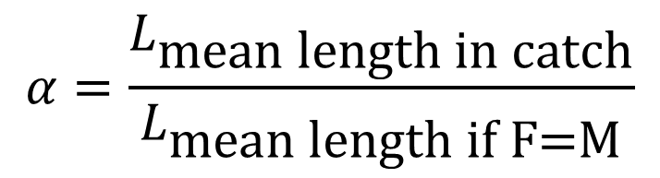
Data-limited harvest control rules Example 1
Catch multiplier based on indicator
Example: based on mean length of catch relative to a target length termed HCR3:
$$C_{y+1}= C_{y−1}α$$
$$α=\frac{L_{\text{mean} \text{length} \text{in} \text{catch}}}{L_{\text{mean} \text{length} \text{if} \text{F}\text{=}\text{M}}}$$
Source: Jardim et al. 2015

Slide 8
Data-limited harvest control rules
High historical exploitation
HCR1
HCR2
HCR3
Developing fishery
Source: Jardim et al. 2015

Slide 9
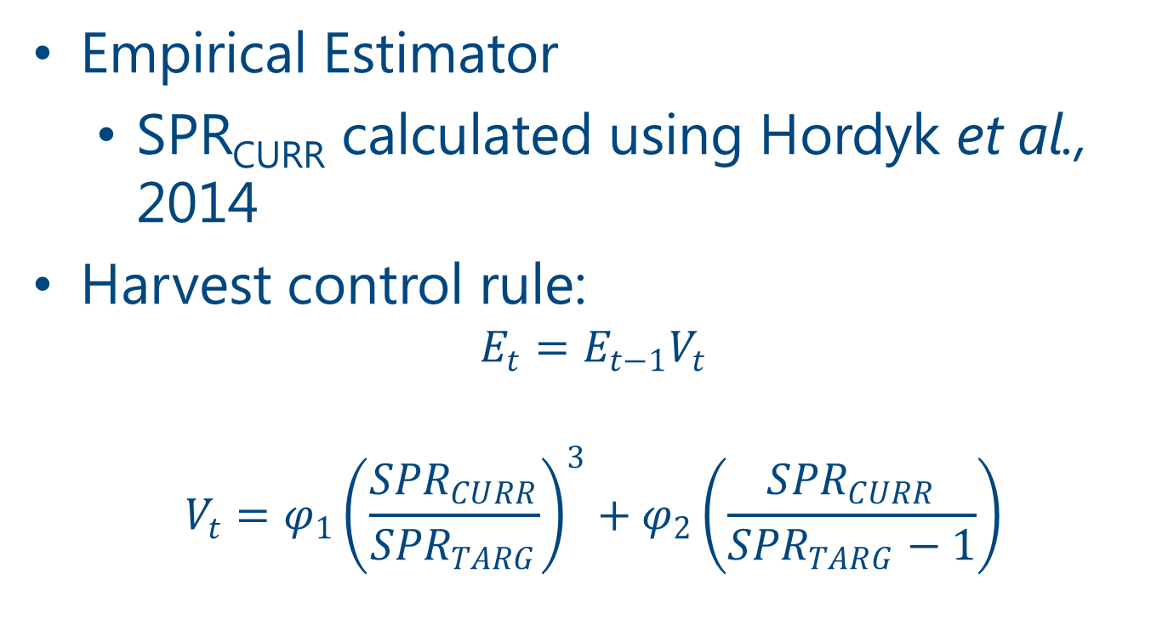
Data-limited harvest control rules: Example 2
Empirical Estimator
SPR_{CURR} calculated using Hordyk et al., 2014
Harvest control rule:
$$E_{t}=E_{t−1}V_{t}$$
$$V_{t}=φ_{1}{\left(\frac{{SPR}_{CURR}}{{SPR}_{TARG}}\right)}^{3}+φ_{2}\left(\frac{{SPR}_{CURR}}{{SPR}_{TARG}−1}\right)$$
Source: Hordyk et al. 2015

Slide 10
Data limited harvest control rule: Example 2
Linear
Cubic
Cubic Polynomial
Source: Hordyk et al. 2015

Slide 11
Source: Hordyk et al. 2015

Slide 12
Pre-specifying assessment uncertainty
A category/tier system is applied in many systems to address uncertainty based on assessment method and limited data
Australia
ICES
US
Less data → increased uncertainty

Slide 13
Risk equivalency across tiers/categories
Stock Status
T1
T2
T3
Adapted from Fay et al. 2011

Slide 14
Example HCR with buffer
OFL
Buffer
Catch or Effort
Reduce
Harvest
F_{MAX}
Buffer
No
Harvest
B/B₀
0
Limit
Target
1.5
U.S. Department of Commerce | National Oceanic and Atmospheric Administration | NOAA Fisheries | Northwest Fisheries Science Center

Slide 15
US west coast stock categorization
Catch
Abundance Indices
Size & Age Compositions
Category 3: Data-Limited (DCAC, DB-SRA)
Category 2: Data-Moderate (XDB-SRA, XSSS)
Category 1: Data-Rich Full Assessment (Stock Synthesis)

Slide 16
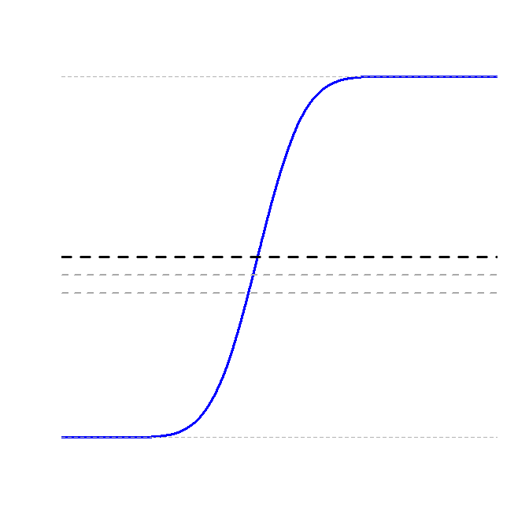
US west coast approach for risk and precaution
Management pre-specifies a desired risk level (≤ 0.50) of over-fishing
50%
45%
40%

Slide 17
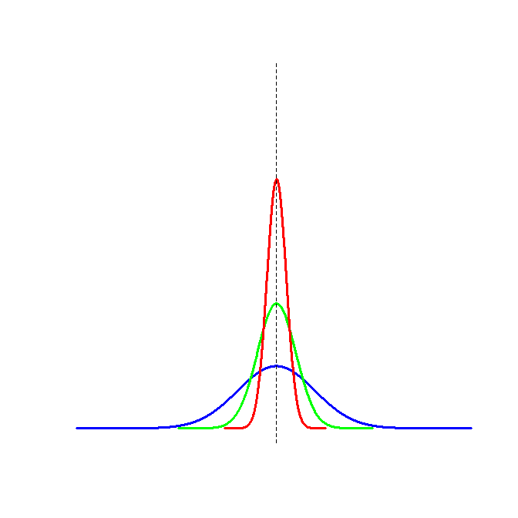
US west coast approach for risk and precaution
Apply precaution based on the uncertainty around current biomass
Final year biomass

Slide 18
US west coast approach for risk and precaution
Combining both risk and uncertainty (σ) (termed “buffer”)
Category 1
OFL
Risk = p(0.45)
σ = 0.36
0.96 * OFL
Category 2
Risk = p(0.40)
σ = 0.72
0.83*OFL
Category 3
Risk = p(0.40)
σ = 1.44
0.69*OFL

Slide 19
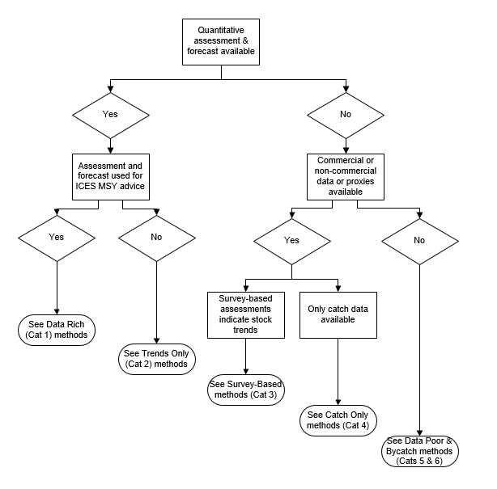
ICES Tier System
Category 1: TAC = 1 * OFL
Category 3: TAC = 0.80 * OFL
Category 4: TAC = 0.80 * OFL

Slide 20
Alternative uncertainty levels
Dichmont et al. 2016. Is risk consistent across tier-based harvest control rule management systems? A comparison of four case-studies. Fish and Fisheries. 17: 731-747
“Our review reveals that best practice is not to define tiers simply on data availability, but also on what the assessments based on those data are capable of estimating”

Slide 21
Evaluating harvest control rules for data-limited to data-poor fisheries
Alternative metrics to estimated stock status for the application and development of HCRs:
Changes in CPUE data
Little et al. 2011. ICES 68: 1699-1705
Trends in indices
Jardim et al. 2015. Fisheries Research. 171: 12-19
Changes in mean length
Klaer et al. 2012. Fisheries Research. 134-136: 42-51
Hordyk et al. 2015. Fisheries Research. 171: 20-32
Jardim et al. 2015. Fisheries Research. 171: 12-19

Slide 22
Management Strategy Evaluation

Slide 23
Management Strategy Evaluation
“The goals of MSE are to support informed selection of a management system by means of quantitative analysis, to make clear the trade-offs among the management objectives for any given strategy, and to identify the requirements for successful management.”
Sainsbury et al., 2000. ICES. 57:731-741

Slide 24
MSE vs. Risk Assessment
MSE incorporates a feedback loop
Accounts for management actions based upon perceived status of the stock
Risk Assessment applies constant management actions into the future.
Overestimates risk

Slide 25
Developing a MSE
Identify management objectives.
Identify a broad range of uncertainties (e.g. biology, environment, management system).
Define operating models.
Identify candidate management strategies.
Simulate the application of each strategy for each operating model.
Summary and interpret outcomes using performance statistics.
Adapted from Punt et al. 2014. Fish and Fisheries. 17: 303-334

Slide 26
Sample ‘true’ population with observation error
Simulates the ‘true’ population
Observation Model
Operating Model
Performance Statistics
Estimation Method
Implements management decisions that feeds back into the population
Management Model
Apply Harvest Control Rule
Repeat many times, and summarize performance of alternative actions against objectives

Slide 27
Data-limited example
Sample ‘true’ population with observation error
Simulates the ‘true’ population
Observation Model
Operating Model
Performance Statistics
Estimation Method:
Average Catch over CPUE stability period
Implements management decisions that feeds back into the population
Management Model
Harvest Control Rule: Catch adjusted based on recent average CPUE relative to target and limit
Repeat many times, and summarize performance of alternative actions against objectives
Source: Little et al. 2011

Slide 28
Developing a MSE – management objectives
The development of an MSE should involve decision-makers and stakeholders
What are the main sources of uncertainty?
What are the objectives of management?
Alternative management measures?
How to evaluate performance?

Slide 29
Sources of uncertainty to consider
Process uncertainty
Trends in biological processes
Trends or changes in selectivity
Parameter uncertainty
Estimated or fixed values
Model uncertainty
Stock-recruit relationship
Selectivity shape
Errors when conducting assessments
Estimation error
Outcome/Implementation uncertainty
TAC removal, under, over

Slide 30
Common sources of uncertainty examined by MSE
Productivity
Non-stationarity in life history parameters
Data-related issues
Errors in data
Data availability
Other
Spatial and stock structure
Time-varying selectivity

Slide 31
Conducting an MSE with DLMTool
Flexible MSE model
Built in examples
Modification needed to tailor to a specific situation
Quickly evaluate a suite of empirical estimators
Can we rule out approaches for deeper evaluation?
Basic diagnostic plots provided

Slide 32
DLMTool Operating Model
Age-structured model
Length based maturity and selectivity
Process error and auto-correlation in process error
Also, allows for non-stationarity in parameters over-time
Recruitment
Options for Beverton-Holt or Ricker SRR
Annual recruitment
Option for cyclic variability
Annual time-step

Slide 33
DLMTool MSE sub-models
Population dynamics
Growth, recruitment, natural mortality
Fishery
Selectivity, historical effort
Observation
Bias and precision of data sources and quality of data
All sub-models are completely stochastic by default

Slide 34
DLMTool Management Strategy Evaluation Sub-models

Slide 35
DLMTool Management Strategy Evaluation Availability of methods

Slide 36
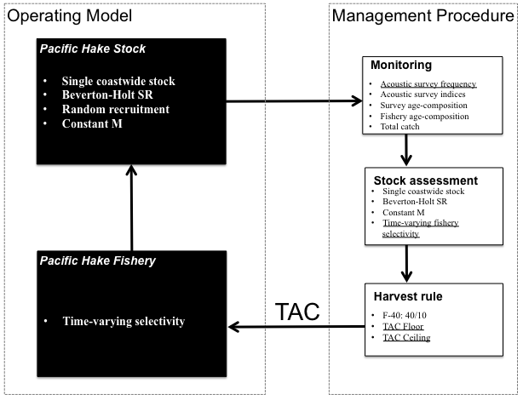
Survey frequency
Time-varying fishery selectivity
TAC floor
TAC ceiling
Source: IJTC 2014

Slide 37
Management period
How long should the management period be?
History of the fishery
Life-history of the species
Anticipate length of estimation approach
Range of years to conduct performance statistics
Long-term vs. Short-term outcomes

Slide 38
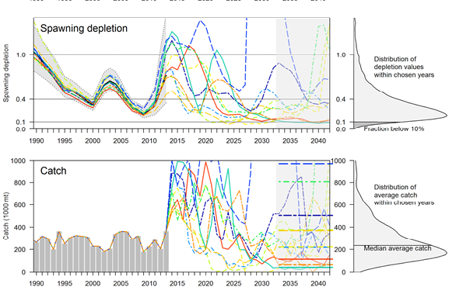
Source: IJTC 2014

Slide 39
Performance Statistics
Should be developed with stakeholders and managers
Allow for ease of interpretation
Examples:
Probability of overfishing
Probability of the stock falling below a stock size
Probability of being within X% of the target biomass
Average catch
Average biomass
Variability in catch

Slide 40
DLMTool MSE caveats
Allows for quick exploration of empirical methods
Omits stakeholder involvement
Can be difficult (e.g. time consuming) to tailor inputs to match a particular situation
Implementation of harvest control rules may be difficult

Slide 41
DLMTool Management Strategy Evaluation tool: Conducting a MSE

Slide 42
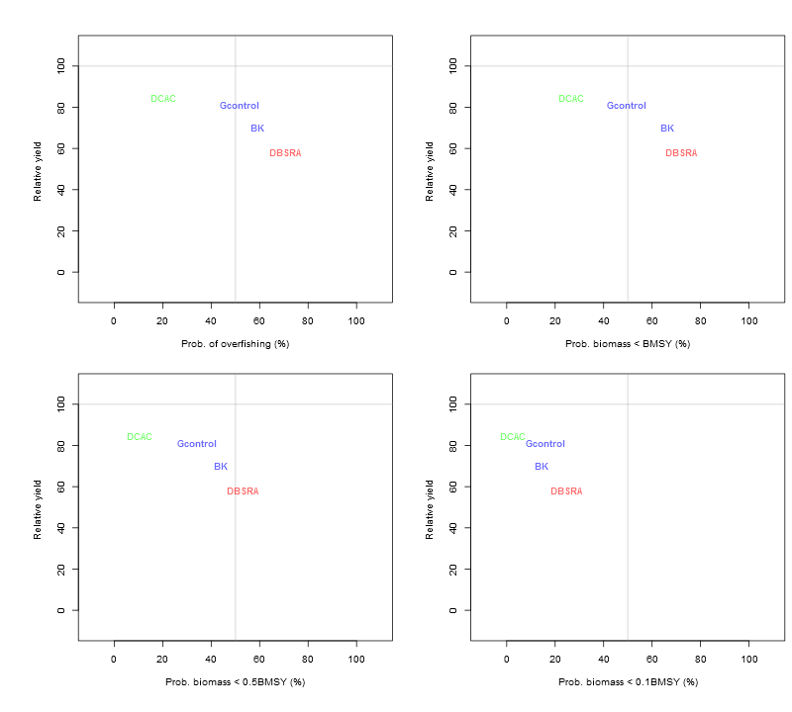
DLMTool output visualization: tradeoffs

Slide 43
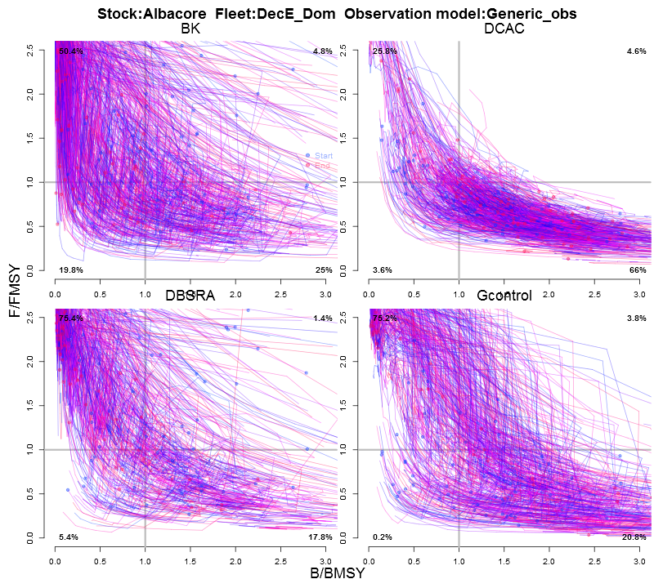
DLMTool: Kobe plot

Slide 44
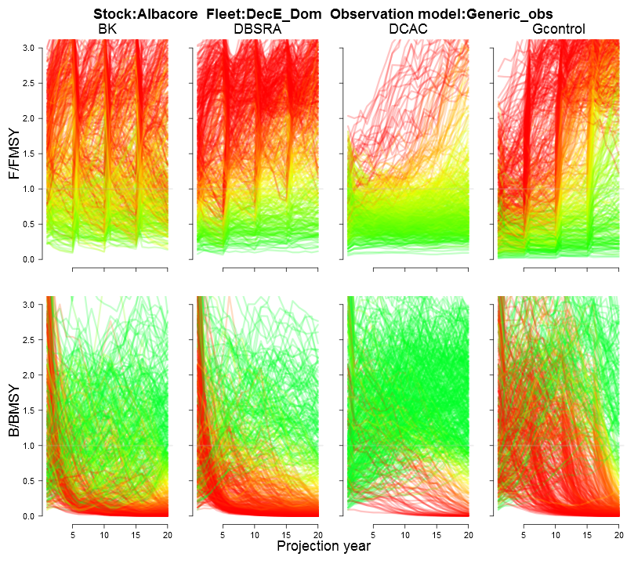
DLMTool: projection plot

Slide 45
Developing an operating model (OM)and MSE
If possible base OM and MSE on developed software
Pro – dynamics of OM and estimation model (EM) match
Con – dynamics of OM and estimation model (EM) match
Test with deterministic system dynamics
Data generate without error
Test with deterministic population dynamics
Quickly evaluate proposed options
Can options be ruled out for further examination?

Slide 46
DLMTool Management Strategy Evaluation tool: Can we make it deterministic?

Slide 47
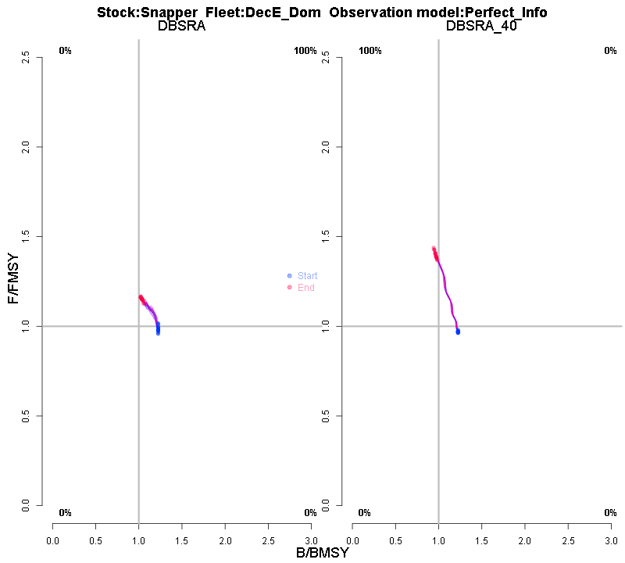
Snapper deterministic example

Slide 48
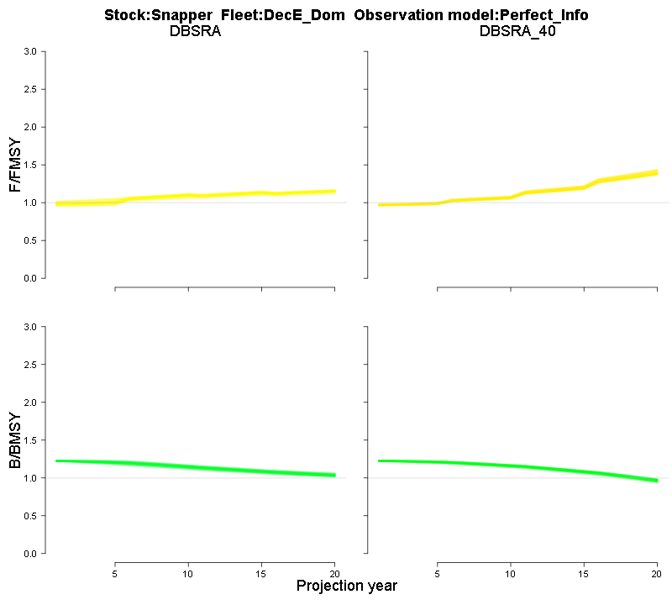
Snapper deterministic example

Slide 49
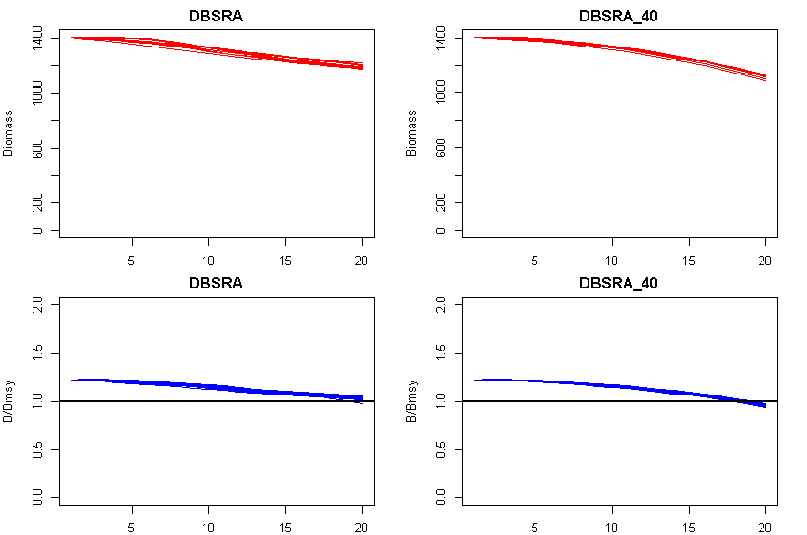
Deterministic Snapper Example

Slide 50
DLMTool Management Strategy Evaluation tool: Downloading output

Slide 51
DLMTool output
Download the MSE output
Drag and drop file into R GUI or use load command in Rtools
load(“C:/file_location /file_name.DMP”)
S4 Object
See what items are apart of the object
slotNames(MSEout)

Slide 52
MSEout classes
# Name - species and configuration
# nyears - historical years
# proyears - projection years
# nMPs - number of management procedures
# MPs - names of the management procedures
# nsim - number of simulations
# OM - operating model values
# Obs - observation model bias and samples
# B_BMSY - ratio over the projection period
# F_FMSY - ratio over the projection period
# B - biomass over the projection period
# FM - F value of the projection period
# C - catches over the projection period
# TAC - TAC over the projection period (can be the same as C)
# SSB_hist - profiles over SSB

Slide 53
MSEout@OM
MSEout@OM
RefY | M | Depletion | A | BMSY_B0 | FMSY_M
76.43329 | 0.210911 | 0.457364 | 514.5066 | 0.302478 | 0.534818
131.6664 | 0.151917 | 0.584144 | 1235.55 | 0.348741 | 0.45261
105.8954 | 0.174511 | 0.522902 | 803.1622 | 0.317026 | 0.533471
152.9788 | 0.181957 | 0.48492 | 1037.043 | 0.256242 | 0.670251

Slide 54
Commands to recreate figures
Check convergence
CheckConverg(MSEout)
Overfishing and relative target over time
Pplot(MSEout)
Kobe Plot
Kplot(MSEout)
Trade-offs plots
Tplot2(MSEout)
TradePlot(MSEout)
Value of information plot
VOI(MSEout)

Slide 55
The code behind the ‘shiny’ curtain
set.seed(1)
# Example in the user manual for an operating model
avail('Stock')
OM <- new('OM', Blue_shark, Generic_fleet, Imprecise_Biased)
slotNames(OM)
# list the parameters in each submodel
OM@Name
# get the cran help file for the OM class
OM@nyears
class?OM

Slide 56
The code behind the ‘shiny’ curtain
# the different assessment options available
avail('DLM_output')
MPs <- c("Fratio", "DCAC", "Fdem", "DD")
# select alternative assessment methods to evaluate
# get the cran help file for this assessment method
?Fratio Fratio # this will show the code for this method
SnapMSE <- runMSE(OM, MPs, nsim=16, reps=1, proyears=30, interval=10)

Slide 57
Advantage of the DLMTool
Pros
Easy to apply
Large suite of available EMs
Quickly evaluate potential outcomes
Incorporates multiple sources of uncertainty
Cons
Can be difficult to customize
EM assumptions not completely apparent
Not all quantities are outputted
Does not allow for mis-specification in the EM
Harvest Control Rules?

Slide 58
Management Strategy Evaluation: Beyond the DLMTool

Slide 59
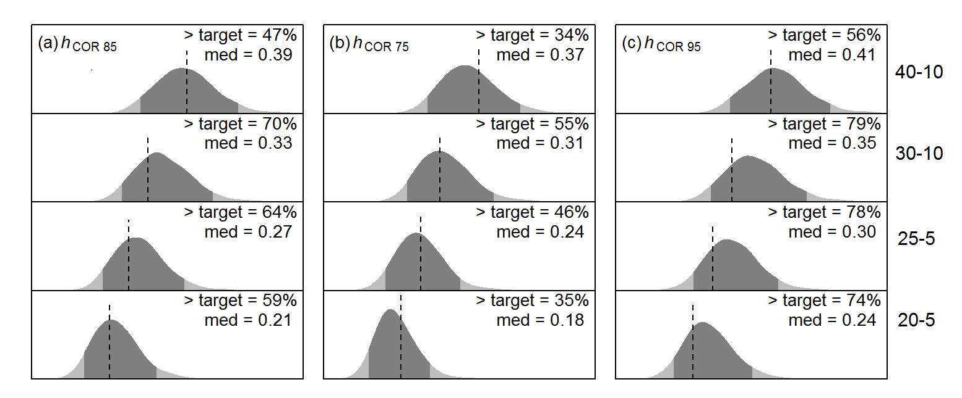
Alternative methods of presenting outcomes
Relative Spawning Biomass

Slide 60
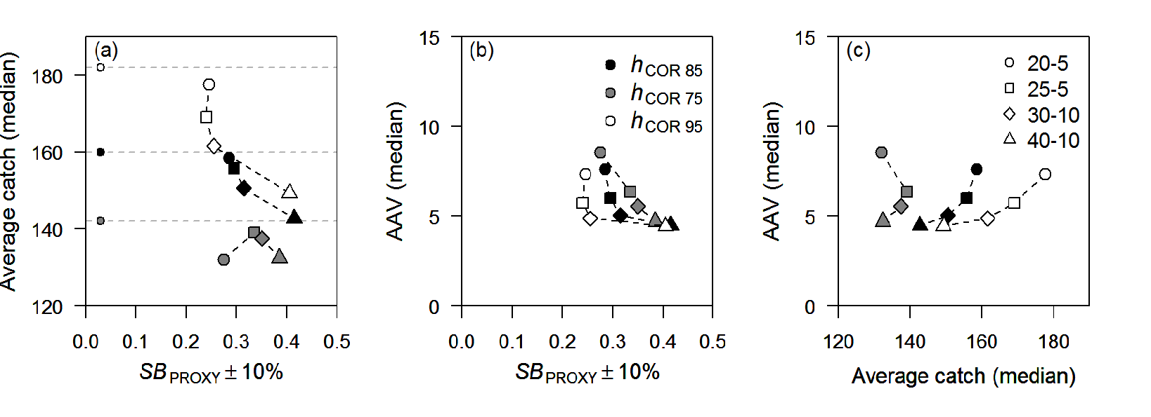
Showing trade-offs

Slide 61
Data-moderate & data-poor MSEs
Bentley and Stokes 2009
Developing MSE for data-limited species
Little et al. 2011
CPUE based harvest control rules
Plaganyi et al. 2013
The tradeoffs between economic and social objectives
McGilliard et al. 2010
Data from marine reserves to inform control rules
Babcock and MacCall 2011
Ratio of fish density from outside versus inside marine reserves
Wilson et al. 2010
Application of management actions to sedentary nearshore species.

Slide 62
MSE: Alternative assessment model
When the assessment method it too complex or time-consuming
Assume estimates of biomass log-normally distributed with auto-correlation in errors
Punt et al. 2008
Advice on auto-correlation
Weidenmann et al. 2015

Slide 63
MSE shortcut
ICES (2013) comments that this it generally not sufficient to simply add random noise
ICES (2008) compared ‘full’ to ‘shortcut’ MSE and found the performance of harvest control rules changed between the approaches

